Slide 1
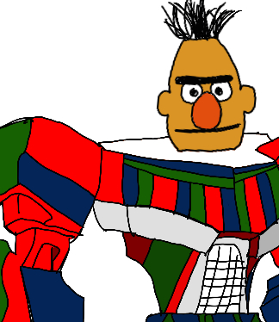
Customer Care with AI-Powered Intent Detection
HiveMind:
Michael Anderson, Sahil Bishnoi, Avery Girsky, Oliver Hewett

Slide 2

Agenda
Objective
Data
Exploratory Analysis
Text Cleaning
Sentiment Analysis
Modeling
TF-IDF
DistilBERT
Results
Recommendations and Next Steps
Q&A

Slide 3
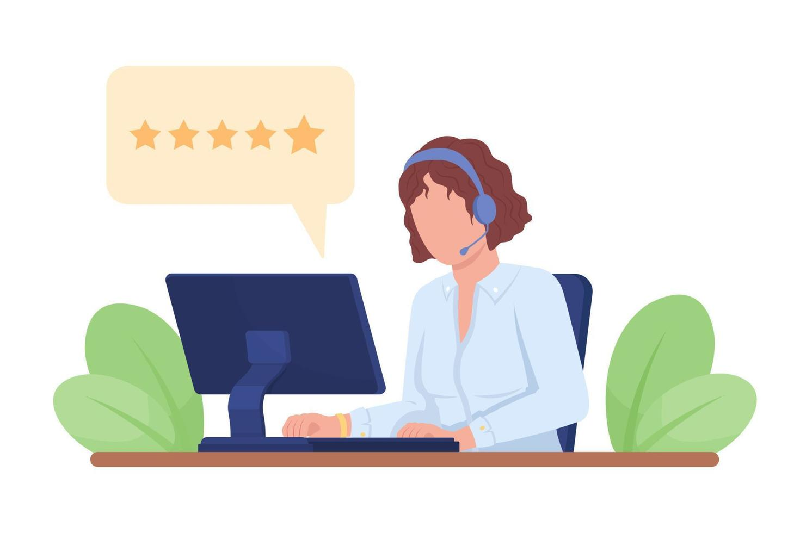
Objective
Purpose: Develop a text classifier to label calls that replicates the capabilities of a large language model (LLM), offering a cost-effective and maintainable solution.
Why Label Calls?
By analyzing call data, we can pinpoint problematic labels. This intelligence is key to targeted agent training and improving overall call quality.
Identify labels with potential for improvement
Negative call sentiment.
Long call duration.
Common patterns.

Slide 4

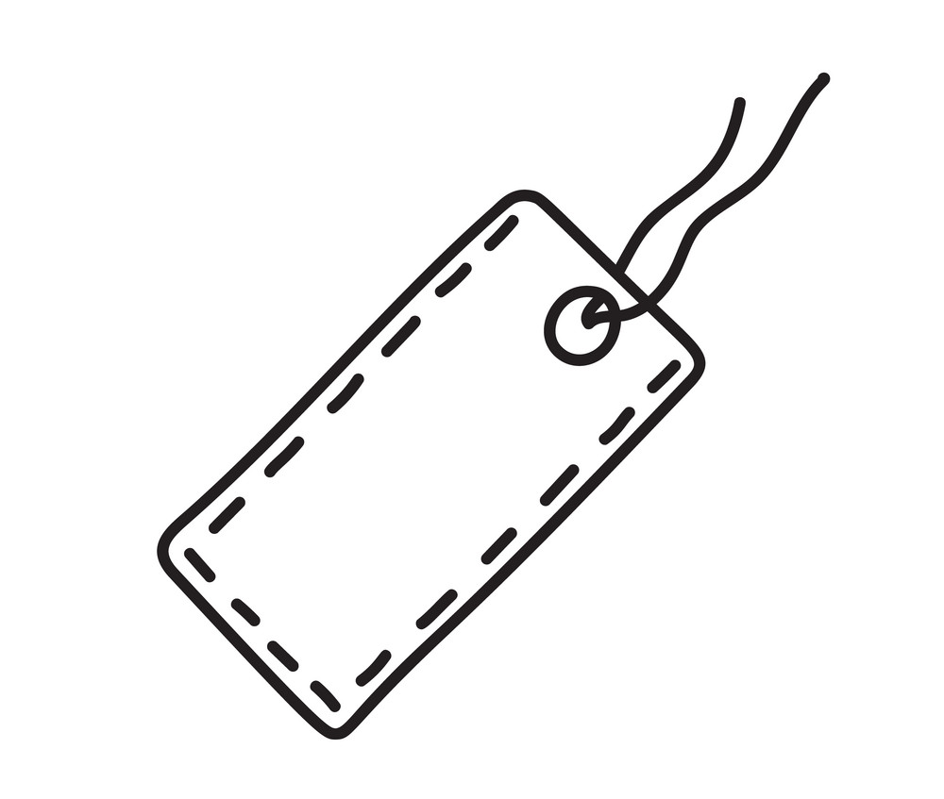
Data
"agent says hi thank you for calling best buy this is name speaking. how may i help you date..customer says uh yes i was calling to see if yall have a.customer says archaeus quest to uh face..customer says insert thing..agent says space insert thing im sorry sir sir. where are you referring to..customer says for date quest two um that uh face..customer says are they sealed in..agent says space name.customer says yeah..agent says are you talking about the cover piece that goes on the goggles like that little white piece..customer says yeah the the the cover yeah um facial yeah.agent says that is something we do not sell separately sir um.customer says alright thank.agent says the only thing i could think of is reaching out to aucklet itself and seeing if they have a replacement for that but we do not sell that separately"
Product Details Inquiry

Slide 5
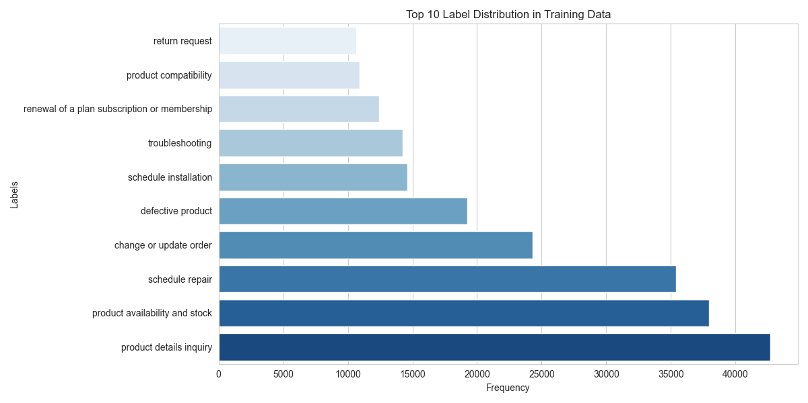
Exploratory Analysis
Call length (in characters) best substitute for actual call time
Many conversations involve similar patterns amongst agents
Motivation for seeking automatable tasks
Most common labels:
Product Details Inquiry
Product Availability and Stock
Schedule Repair

Slide 6
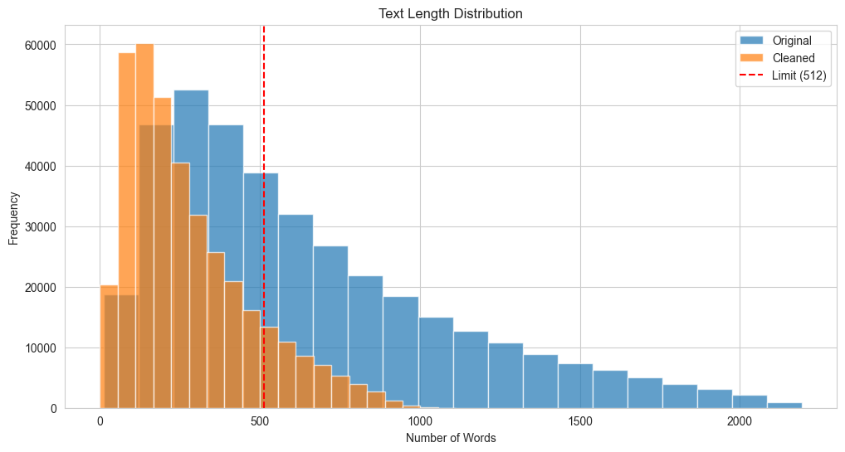
Text Cleaning
Purpose:
Improves performance
Model feasibility
50.22% of observations over 512 words before cleaning
13.31% of observations over 512 tokens after cleaning
Method:
Adjust punctuation
Remove stopwords, non-content words, and redacted information
Remove non alpha-numeric characters
*We implemented lemmatization as well, but saw lower scores

Slide 7
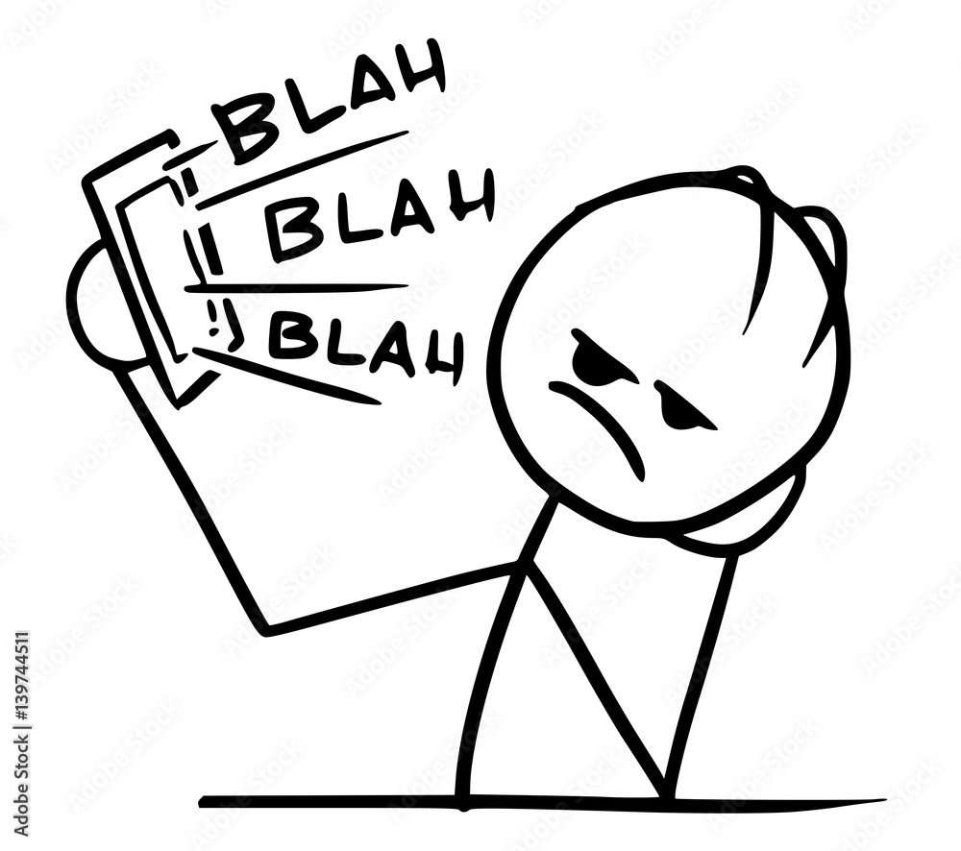
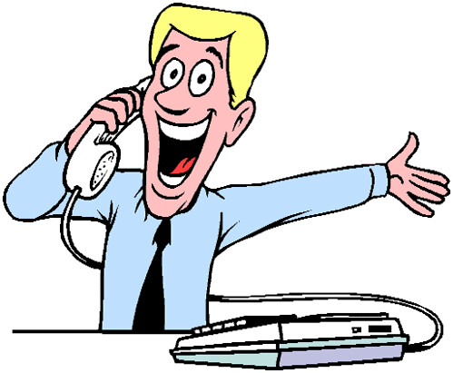
"agent says hi thank you for calling best buy this is name speaking. how may i help you date..customer says uh yes i was calling to see if yall have a.customer says archaeus quest to uh face..customer says insert thing..agent says space insert thing im sorry sir sir. where are you referring to..customer says for date quest two um that uh face..customer says are they sealed in..agent says space name.customer says yeah..agent says are you talking about the cover piece that goes on the goggles like that little white piece..customer says yeah the the the cover yeah um facial yeah.agent says that is something we do not sell separately sir um.customer says alright thank.agent says the only thing i could think of is reaching out to aucklet itself and seeing if they have a replacement for that but we do not sell that separately"
"hi thank calling best buy name speaking may help date customer yes calling see yall archaeus quest face customer insert thing agent space insert thing im sorry sir sir referring to customer date quest two face customer sealed in agent space yeah agent talking cover piece go goggles like little white piece customer yeah cover yeah facial something sell separately sir alright thing could think reaching aucklet seeing replacement sell separately"

Slide 8
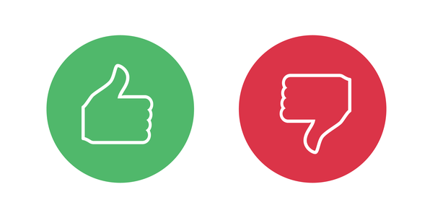

Sentiment Analysis
Understanding sentiment of service calls allows us to realize areas of improvement for customer care
TextBlob: Pre-trained library used for determining the polarity of text
hi thank calling best buy name speaking may help date customer yes calling see yall archaeus quest face customer insert thing agent space insert thing im sorry sir sir referring to customer date quest two face customer sealed in agent space yeah agent talking cover piece go goggles like little white piece customer yeah cover yeah facial something sell separately sir alright thing could think reaching aucklet seeing replacement sell separately
-1
0.0625
1

Slide 9
TF-IDF
Term Frequency-Inverse Document Frequency
Vectorize inputs by assigning each token a score
Score increases with high frequency of a token within its conversation and low frequency across the entire document
Modeling
Vectorized inputs fed into two models:
Logistic Regression
XGBoost
Context Performance
Explainability Efficiency

Slide 10
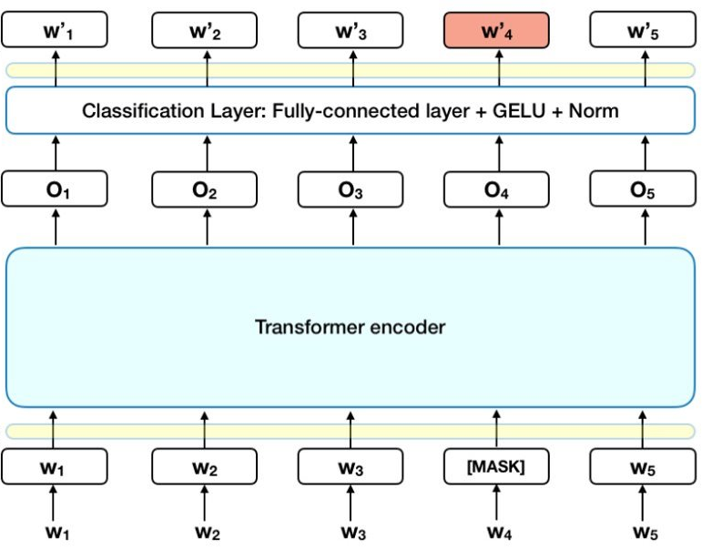
(distil)BERT
Bidirectional Encoder Representations from Transformers
Preprocessing
Tokenization, Positional Encoding, Embedding, Masking
Pre-Training
Model pre-trained on large text corpus
Transformer
Attention: Each token gives attention score to every other token
Feed-forward network: fine-tuned on our training data and labels
Output
SoftMax probability for each label
DistilBERT
40% less parameters than BERT
60% faster runtime
95% of performance preserved (by GLUE benchmark)

Slide 11
Results
Classifier | F1 Score
Validation
TF/IDF
Logistic Reg. | 0.5884
XGBoost | 0.5613
DistilBERT
Base | 0.6746
Adapted | 0.6945
Micro F1 Score
Harmonic mean of precision and recall that accounts for class imbalance
DistilBERT
Base
Batch Size = 32
Epochs = 3
Learning Rate = 5e-5
Adapted
Epochs = 4
Variable Learning Rate = Decay [3e-4, 1e-4, 5e-5, 1e-5]
Masking = 0.15
Test
DistilBERT Adapted | 0.6950
*Masking: Randomly hide input tokens during model training

Slide 12
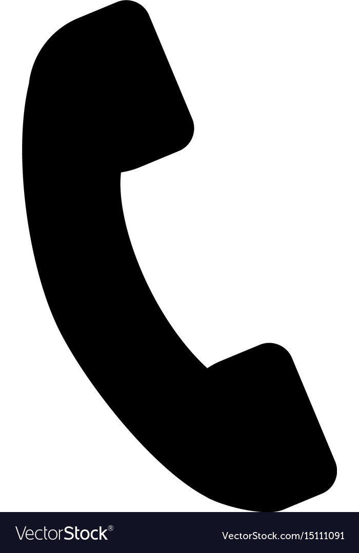
hi thank calling best buy name speaking may help date customer yes calling see yall archaeus quest face customer insert thing agent space insert thing im sorry sir sir referring to customer date quest two face customer sealed in agent space yeah agent talking cover piece go goggles like little white piece customer yeah cover yeah facial something sell separately sir alright thing could think reaching aucklet seeing replacement sell separately
Product Availability and Stock
Product Details Inquiry
Every Other Label
0.91095
0.08876
< 1e-4

Slide 13
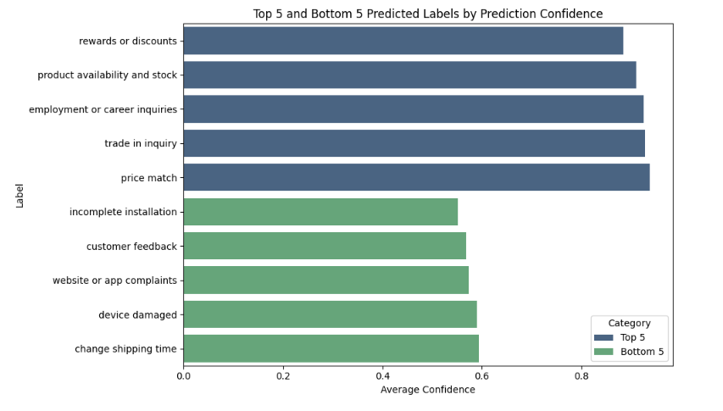
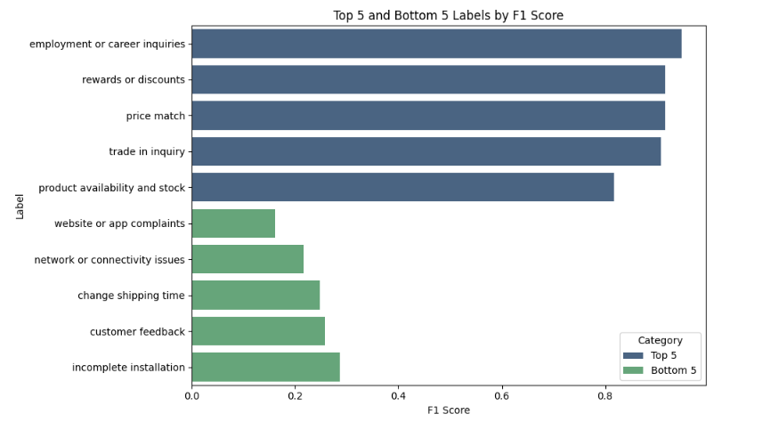
Results and Model Improvement
Top 5 and Bottom 5 Predicted Labels by Prediction Confidence
Top 5 and Bottom 5 Predicted Labels by F1 Score
Model is excellent at predicting when it is confident!
The top five labels by F1 score are rearranged as the top five by prediction confidence
Four of the bottom five labels by F1 score are in the bottom five of prediction confidence
Model Improvement: [Hyperparameter optimization]
More epochs, decaying learning rate
Regularization/dropout

Slide 14
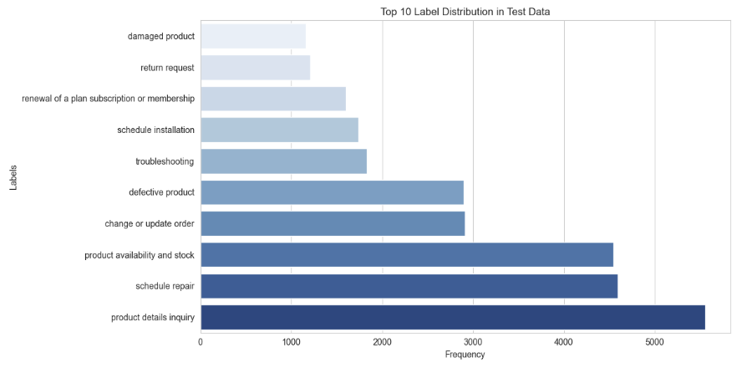
Business Application
Through our distilBERT-powered test dataset labels, we identify the top labels with most calls, long duration, and strong sentiment (negative and positive)
Top 10 Label Distribution in Test Data
damaged product
return request
renewal of a plan subscription or membership
schedule installation
troubleshooting
Labels
defective product
change or update order
product availability and stock
schedule repair
product details inquiry
Frequency
Automate most common calls, save both agent and customer time

Slide 15
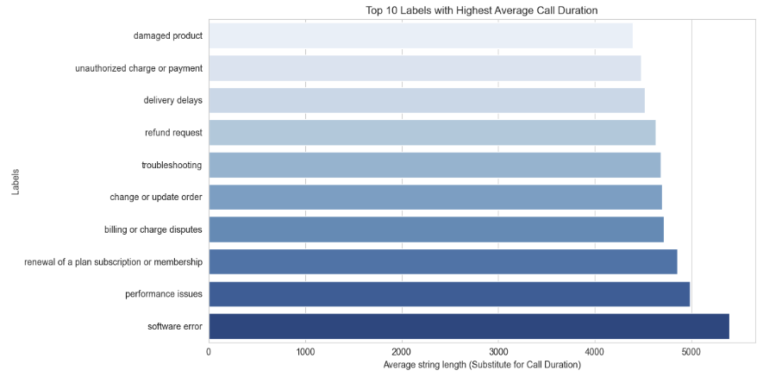
Business Application
Through our distilBERT-powered test dataset labels, we identify the top labels with most calls, long duration, and strong sentiment (negative and positive)
Top 10 Labels With Highest Average Call Length
damaged product
unauthorized charge or payment
delivery delays
refund request
Labels
troubleshooting
change or update order
billing or charge disputes
renewal of a plan subscription or membership
performance issues
software error
Average String Length (Substitute for Call Duration)
Train call center employees at reducing lengthy phone calls on these labels

Slide 16
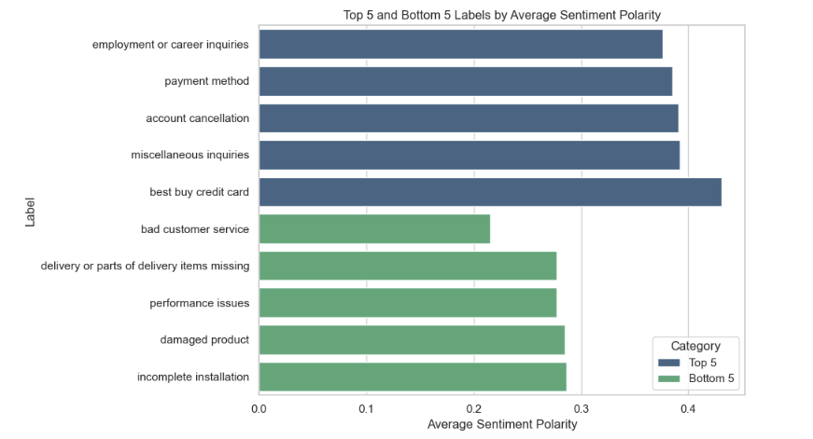
Business Application
Through our distilBERT-powered test dataset labels, we identify the top labels with most calls, long duration, and strong sentiment (negative and positive)
Top 5 and Bottom 5 Labels by Average Sentiment Polarity
employment or career inquiries
payment method
account cancellation
miscellaneous inquiries
best buy credit card
Labels
bad customer service
delivery or parts of delivery items missing
performance issues
damaged product
incomplete installation
Average Sentiment Polarity
Train call center employees at approaching the above situations with potential for negative sentiment

Slide 17
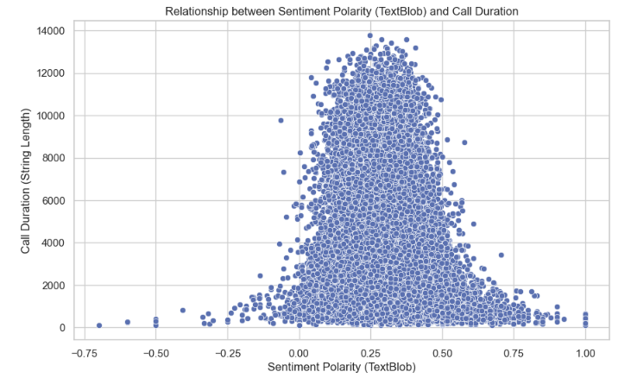
Business Application
Weak negative correlation between call duration and sentiment polarity
Labels with the highest average call duration:
Software Error
Performance Issues
Renewal of Subscription/Membership
Pinpointing roadblocks with tailored training can save time and facilitate a better customer experience
R = -0.23

Slide 18
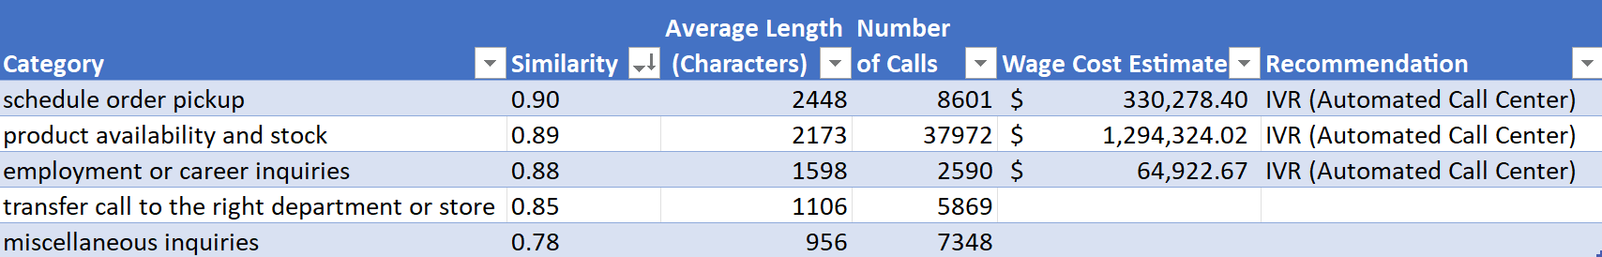
Recommendations and Next Steps
IVR (Automated Call Center)
With non-anonymized data, perform analysis by:
Product Number, Location, troubleshooting type, etc.

Slide 19
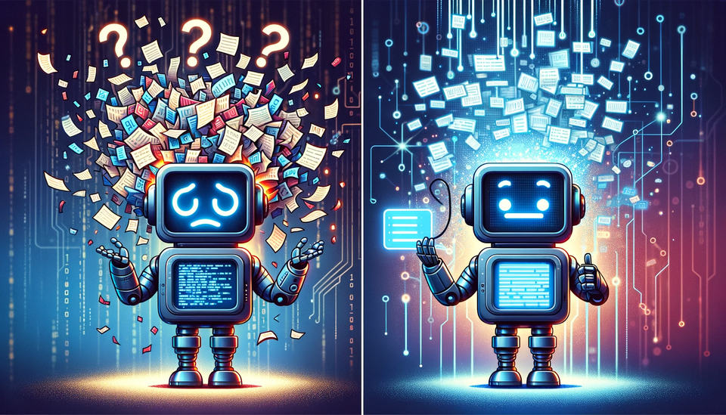
Q&A

